Slide 1
ISP Price and Speed Comparison
By: Brendan Blasius & Alex Woersching

Slide 2

Implementation
Database
SQLite3
Python
Website Backend and Frontend
Hosted on Python Dash - built off Plotly.JS
Use of SQLite3 python library for queries
PANDAS as mediator for data
Users
User inputs information to display local ISPs and prices

Slide 3
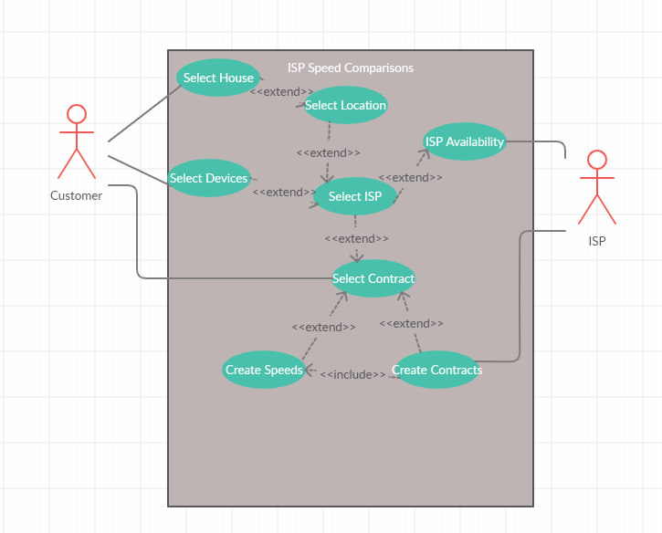
USE-CASE

Slide 4
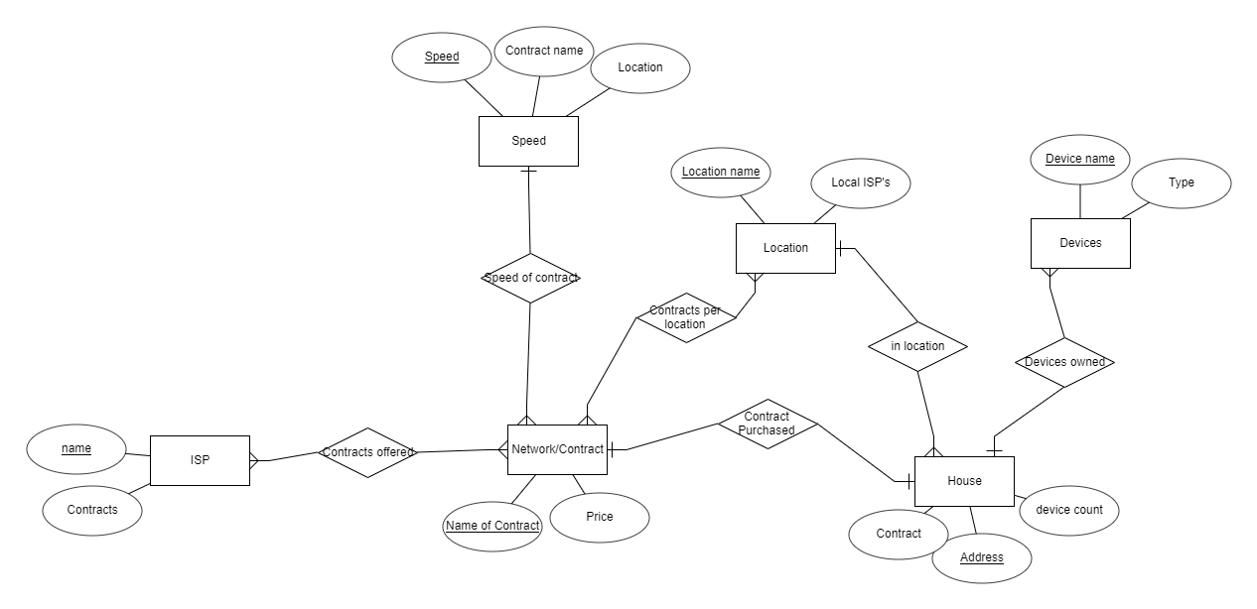
E/R Diagram

Slide 5
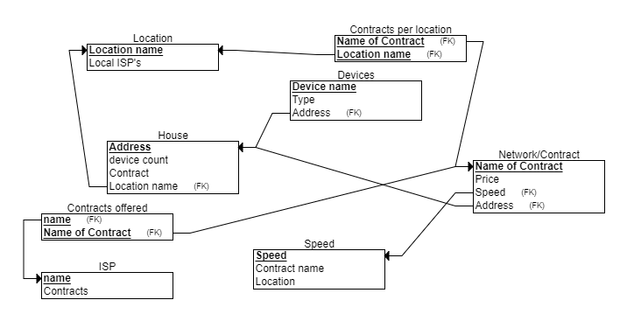
Relational Schema

Slide 6
Thank you

